Slide 1
Just One More Ministry
A Non-Profit
Take in Food Donations and Redistributes them around Milwaukee
Use QuickBooks to keep track of Incoming and Outgoing Donations

Slide 2
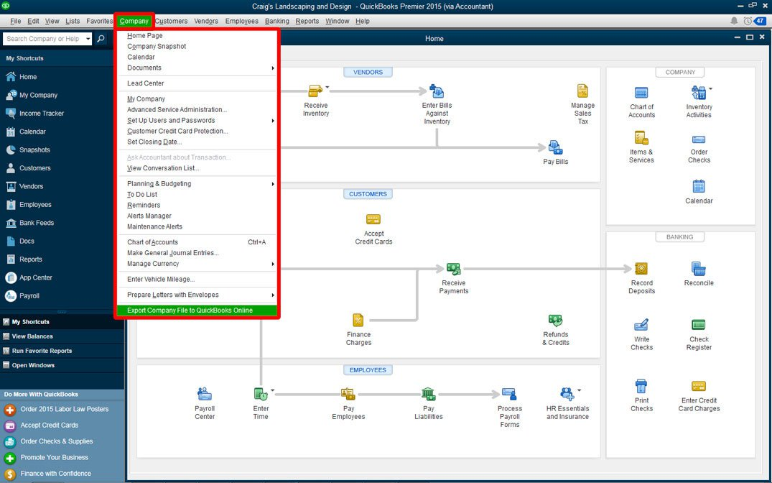

Slide 3
What Do They Want?
A system that is simple
A system that will allow them to perform their daily tasks as fast and efficient as possible
Build Reports
Enter, View, and Edit Partner Organization Information
Enter Incoming and Outgoing Donations

Slide 4
Our IUI Idea
Create a system that is able to adapt to users via user modeling
Pattern Recognition
Take the user to their most likely destination
Create Reports
Figure out which partner the user will be entering donations for and which kind of donations
Create a system that works on multiple devices
Build website on a local server
Utilize Multimodal inputs to Maximize User Efficiency
WIMP
Voice Commands

Slide 5
Testing
Ask users of the current system to write down their intended actions before performing them
This will be the basis of the testing data set
Give them our program with the test set
Assess how many times the user had undo, add, or remove automations
Assess how many times the voice command performed an unintended action
Give them a usability questionnaire (SUS)

Slide 6


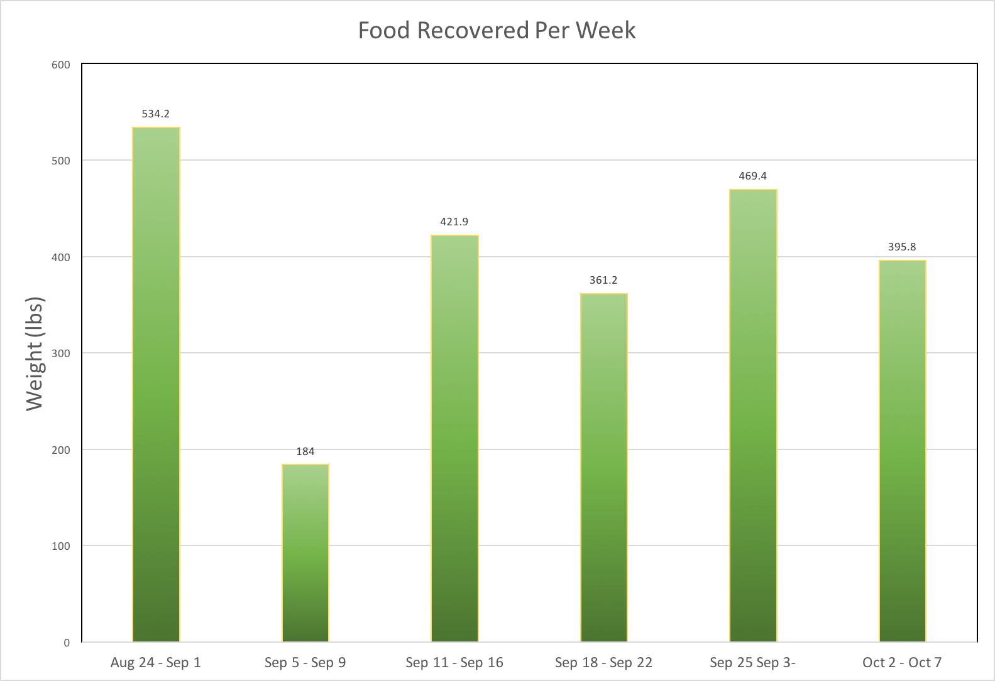
Incoming Donations
Outgoing Donations
Partner Organizations
Reports
Activate Voice Commands

Slide 7
Enter Organization:
Text box to enter org
Food Category
Weight (lbs)
Deli
25
-
Text box to enter food category
Text box to weight
+
Enter into database
Back
Notes:
Incoming and Outgoing Donation Screens.
The Only food Categories are Bakery, Deli, Dairy, Meat, Produce, & Pantry

Slide 8
Search for a Partner
Drop Down Search Box
Select
List All Incoming Partners
List All Outgoing Partners
Add New Partner
Back
Notes:
Partner Organizations Screen. The dropdown search bar need to search both incoming and outgoing tables if the layout of the page is kept like this. I don’t know how difficult will be, so if it becomes to difficult we can create separate search pages for incoming and outgoing partners.

Slide 9
List of all incoming/outgoing partners
Org A
Org B
Org C
Etc.
This page is the same for both incoming and outgoing, only difference is the partner orgs. The user can select one of these orgs to view their information or edit it.
Back

Slide 10
Org A
Contact Info
Name of person to contact: Blah
Contact number:xxx-xxxx
Email address: blah@blah.blah
Notes
Org A comes on this day, and receives food
Edit Contact info
Edit Notes
Back
Notes:
This is the page for looking at a partners information

Slide 11
Org A
Contact Info
Name of person to contact: Blah blah
Contact number:xxx-xxxx
Email address: blah@blah.blah
Notes
Org A comes on this day, and receives food
Finish Editing
Edit Notes
Back
Notes:
This a page where someone decides to edit the contact info. Once the user presses finish editing, either the system could check for changes in the associated column of org A, or could just rewrite each column.

Slide 12
Enter Partner Name:
Text Box to enter the new partner’s name
Submit
Back
Notes:
Add a new partner page, the user enters the name first, then can enter that partners contact info and notes which is given on the next page

Slide 13
Name of the partner just entered
Name of main Contact:
Text Box to enter main contacts name
Phone Number:
Text Box to enter phone number
Email:
Text Box to enter email
Enter Notes (optional)
Text Box to notes
Submit
Back
Notes:
Once Name of main contact, phone number and email are filled in, a new entry in the incoming/outgoing partner table should be created with these associated field placed into their respective columns

Slide 14
Generate a Report
Theseare check boxes
Incoming Partners
Outgoing Partners
Select Dates
Year To Date
To
Generate Report
Calendar buttons
Back
Notes:
This is the reports page. This is the page where I think a better system can be used. Let me know if you have any suggestions for how to change this page.
Selecting the year to date button will automatically place 1/1/17 to the current date. We will need to come up with a way we would like to generate reports.

Slide 15
User Log in
Username:
Username textbox
Password:
Password Textbox
Enter
Create New User
Back
Notes:
Log in page
Checks the user table for a match in the username. Then checks the column associated with a hashed password to check for a match.

Slide 16
Create New User
Enter User Name:
Textbox
Enter Password:
Textbox
Retype Password:
Textbox
Enter
Back
Notes:
New User Page
Should create a new user entry within the user table, and the password should be hashed and stored in its respective column

